Slide 1


Slide 2
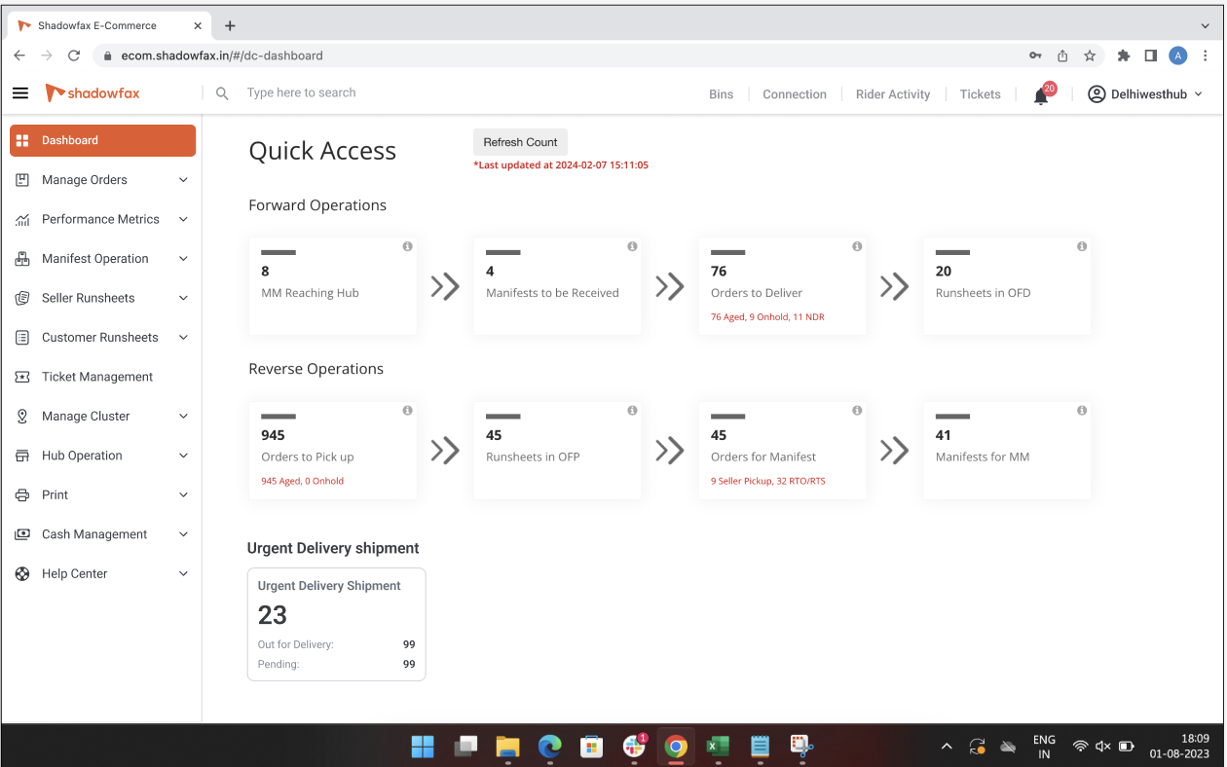
Highlighting UDS on the home page to drive action
UDS is added in the Hub portal for easy view to HI

Slide 3
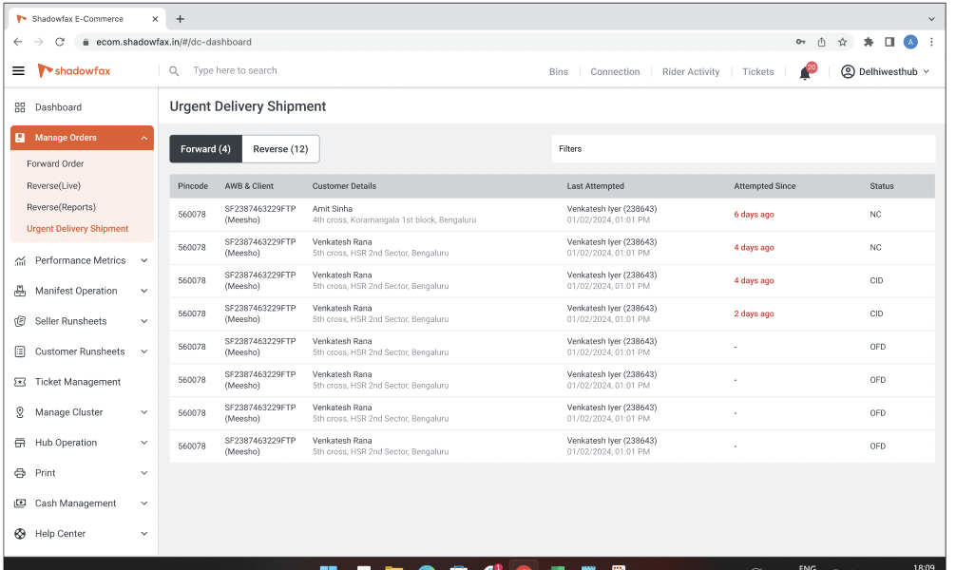
Listing UDS for forward & RVP with required details to help HI take action
HI Can view UDS from here
High Ageing shipments will shown on top in hub portal

Slide 4
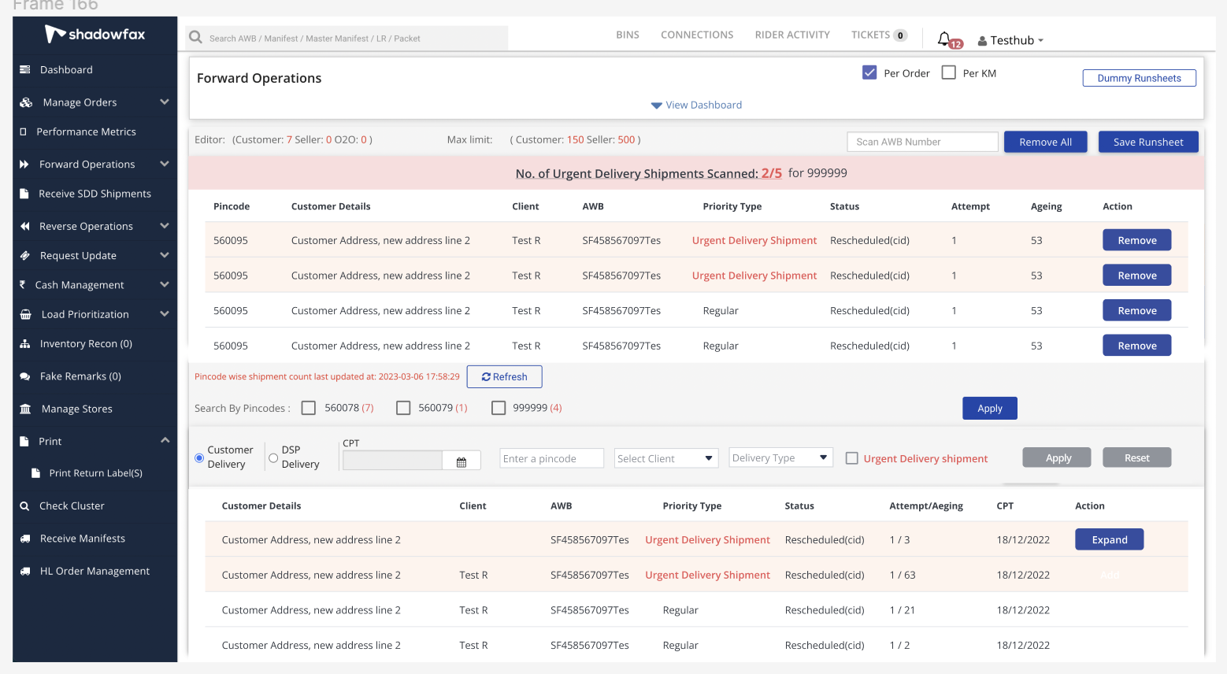
Runsheet creation: UDS will shown at the time of run sheet creation

Slide 5
Runsheet creation: UDS will shown at the time of run sheet creation

Slide 6
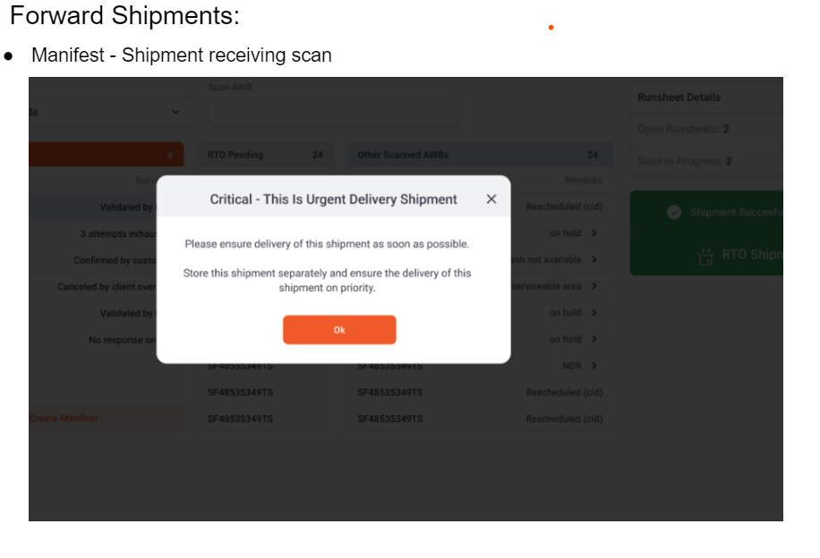
Pop up during forward scan

Slide 7
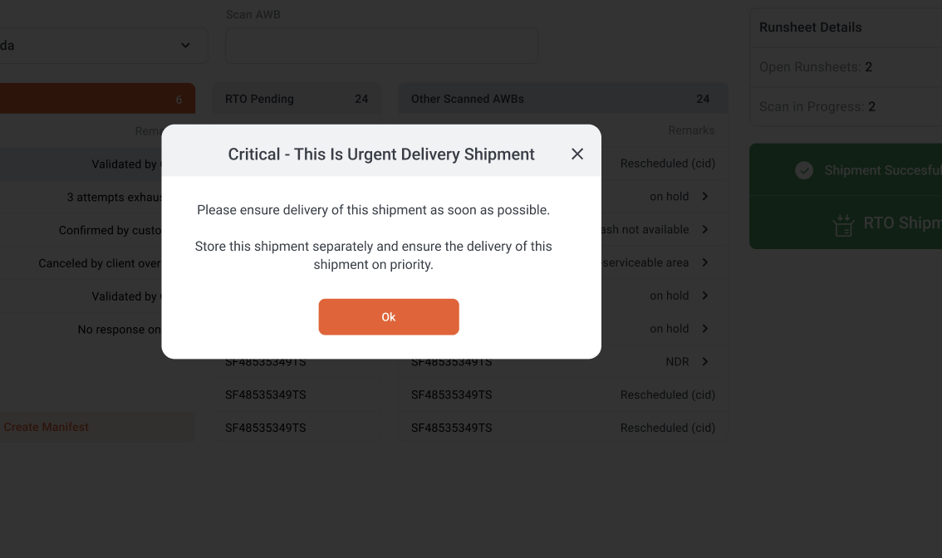
Runsheet closure & Inventory scanning: Pop will come during run sheet closure and inventory scan

Slide 8
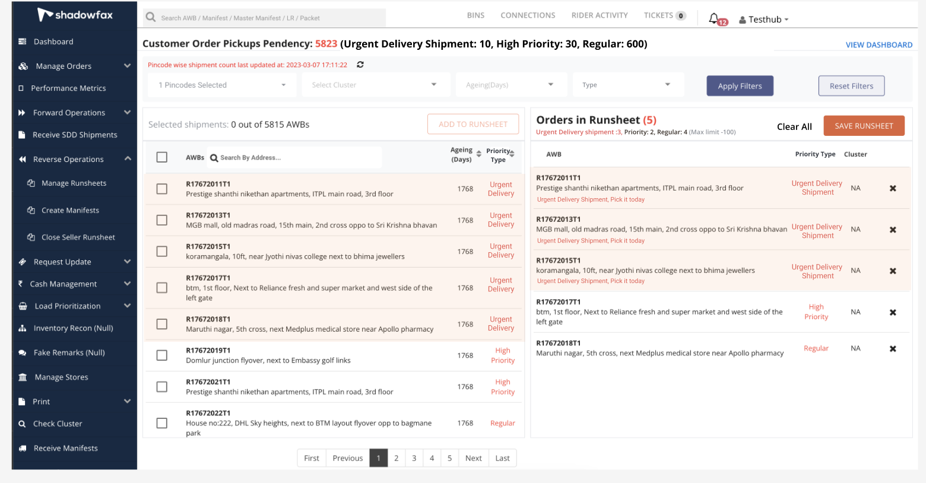
Runsheet creation in Reverse: it will show UDS- Urgent delivery shipment

Slide 9
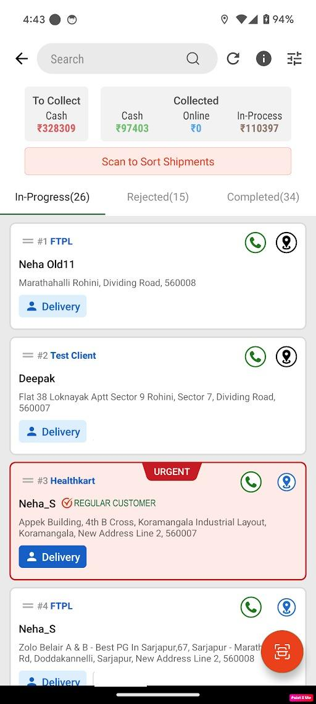
Rider App now will have UDS RED for URGENCY
Latest rider app visibility: The following features have been added:
UDS - Urgent delivery required

